Slide 1
A short briefing on Planning for Parish and Town Councillors February 2023 presented by David Kaiserman BA DipTP MRTPI

Slide 2
My background
local govt. planner since 1966, first with Manchester City Council (my home town), then the Greater Manchester Council (directly-elected strategic planning authority)
back to the City on abolition of GMC (1986) – became Acting Director of Planning
from 1996, a Planning Inspector (until 2014) and trainer of Planning Committees and officers around the UK
independent examiner of neighbourhood plans

Slide 3
Agenda for today
We’re going to cover:
the overall context for the planning system
what needs planning permission and what doesn’t?
making the decision: what’s taken into account?
(a) the policy framework
(b) other “material considerations”
who gets to be involved?
the choices for the planning authority – approve? refuse? defer? Types of permission and the use of conditions
the appeals system
Notes:
3

Slide 4
We won’t have time to look at (for example):
how plans are prepared
specific policies (such as housing or the Green Belt)
S.106 planning obligations and the Community Infrastructure Levy
the enforcement regime
how to ensure probity in decision-making

Slide 5
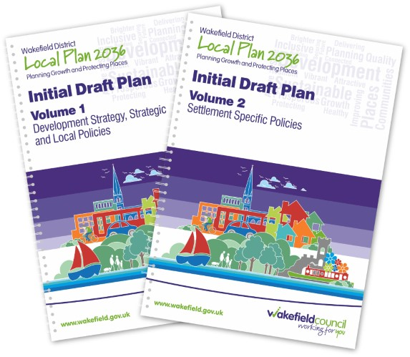
Planning law and planning policy

Slide 6
the planning system naturally has to operate in accordance with a legal framework. This is established by Parliament, but sometimes has to be interpreted by the courts. We’ll look at some key points soon
but on a day-to-day basis what matters more is the application of planning policy - which is found in the local plan, any neighbourhood plans and related documents, but can also be strongly influenced by the Government of the day

Slide 7
Government’s priorities: “growth, growth, growth”…..
- which they often say needs more de-regulation – so fewer planning controls and “red tape” generally
emphasis on “enabling”, not simply “controlling” development
they frequently say decision-taking needs to be quicker and provide more “certainty”
increased house-building seen as key to meeting economic, as well as social, priorities

Slide 8
C17
BUT FIRST, IS PLANNING PERMISSION NEEDED?

Slide 9
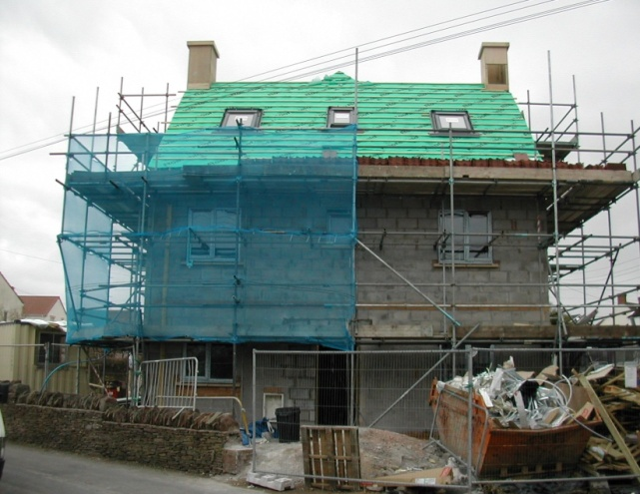
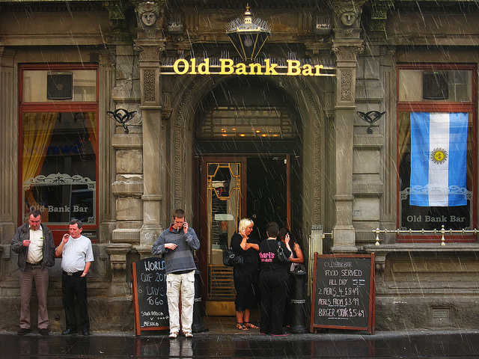
What is “development”?
“The carrying out of building,
engineering, mining or other
operations in, on, over or
under land…..”
“….or the making of any material change in the use
of buildings or other land”.
Town and Country Planning Act 1990 Section 55

Slide 10
these legal definitions come from “primary” legislation – in other words, an Act of Parliament. “Secondary” legislation (much easier to introduce, with less Parliamentary scrutiny) fills in the detail – which, of course, is where the Devil is
some proposals don’t need planning permission because they constitute “Permitted Development”
and some changes of use are not held to be “material” – so they are removed from the definition of development altogether – this is in the Use Classes Order
these are examples of secondary legislation – we’ll look at the key points of both of them

Slide 11
Permitted development rights
“Permitted Development” is a national grant of permission for certain building works and some changes of use
complex limitations on size, height etc, and some “prior approval” requirements (which we’ll come to)
familiar examples:
house extensions, walls and fences, garages, sheds
temporary buildings and uses
agricultural buildings and operations
works by statutory undertakers & local authorities etc

Slide 12
The Use Classes Order
changes of use within the same Use Class are, by definition, not “material”, so don’t need planning permission and can’t be controlled. Changes of use between Classes will be material, by definition
a “material” change of use will usually need planning permission – a few of these are defined in the Act (eg sub-division of a house into two flats), but the detail is in the Use Classes Order
sometimes the courts have had to be involved – much depends on the facts in a particular case: examples – intensification of a use, or mixed uses

Slide 13
Recent deregulation
in the hope of quickly boosting the supply of housing, and to “remove barriers to growth” etc, the Johnson Govt significantly expanded what building and what changes of use can be carried out without planning permission
each category comes with complex requirements and provisos
a brief summary follows: I’ve added more detail as an appendix to the presentation

Slide 14
new permitted development rights to extend existing and create new dwellings
roof-top extensions to enlarge existing dwellings
can add 1-2 storeys on top of existing dwellings, detached, semi- or terraced (some Councils want to protect supply of bungalows….)
creation of new dwellings
up to 2 storeys on top of existing flats, or commercial or mixed-use buildings at least 3 storeys high
max height of 18m (30m for terraces)
only for buildings constructed 1948-2018
demolition and rebuilding
can demolish unused pre-1990 buildings to rebuild a block of flats or a house
must be same footprint and no more than 7m taller than original

Slide 15
less ability to control changes of use
the old Use Classes Order has gone, but the principle is the same as before: changes of use within the same Class don’t need planning permission
but there has been a complete overhaul: the reduction from 18 classes to 10 – so a smaller number of wider classes, giving much more flexibility for property owners and developers (and so less ability for the Council to control, whatever their planning policies might be trying to achieve)

Slide 16
The Use Classes
The one that probably matters most is the extremely wide Class E commercial, business and service uses, including shops, offices, restaurants and cafes, light industry, assembly and leisure etc
Others groups include various types of housing (HMOs are in a class of their own), businesses, institutions, community uses etc
I’ve included the full list of classes in the appendix
and some uses are “Sui Generis” (ie in a Class of their own – or in no Class). So to change to or from these will require permission – eg pubs, wine-bars and takeaways, night clubs and hostels

Slide 17
and a significant expansion to permitted development rights
now any commercial, business and service uses [ie within the new Class E group] – can change to residential up to max of 1500 sq m without planning permission. This means practically all high-street uses
these changes are exempt from developer contributions, so it’s not possible for the Council to negotiate gains such as affordable housing

Slide 18
“prior approval” before work starts
after heavy criticism of the quality of new housing being created, compliance with national space standards is now mandatory, plus “provision of adequate natural light”
other “prior approval” requirements depend on circumstances, but may include
- residential amenity
- contamination, flood risk
- design / external appearance / heritage
- traffic
- harm to views
if prior approval is not granted, many PD rights can’t be exercised. There’s a right of appeal if it’s refused

Slide 19
What “PD” is subject to prior approval? (the main ones) Following concerns over the impact of deregulation, these all need prior approval
upward residential extensions
larger single-storey house extensions
changes of use from non-residential to residential
changes of use from agricultural buildings to residential (this is permitted development up to 5 dwellings)
new dwellings after demolition of existing buildings
certain agricultural / forestry development
telecomms development (eg mobile phone masts)
A fee is payable for consideration of the prior approval application

Slide 20
“Article 4 Directions”
PD rights can be removed by the Authority. This can apply to a specific planning permission or to a geographical area – which Govt. says must be the smallest possible to serve a planning purpose
no examples are given in guidance, but the need to protect the availability of local employment space or the integrity of a design would be justified

Slide 21
“Red Tape” – or sensible controls?

Slide 22
some questions about deregulation
will the expanded PD rights actually achieve anything? Some Councils are already using “Article 4 Directions” to try limit the harmful impact; and there’s little evidence that they’ve been welcomed by the development industry at large
how will these “simplifications” deliver on the Government’s stated priorities? Delivering affordable housing? Achieving better quality? Regenerating town centres? No research seems to have been done beforehand
given the scale of prior approval now required, how will this be different from how planning applications are considered? Councils will spend just as much time on the decision as before. What’s the gain?
last Govt said it would carry out an impact assessment of the changes – no sign of it yet

Slide 23
Anything not clear?

Slide 24
Let’s assume an application is necessary….

Slide 25
Firstly, who decides?
planning permission isn’t a licence granted to an individual – it goes with the land (until it expires). So who decides whether to grant it?
around 90% are decided by Council officers under “delegated powers”, not elected Councillors [see your local “Delegation Scheme” for the details]
around 14% annually are refused* – of those, around 8% are taken to appeal, and about a third of those succeed
* England only figure (2021-2)

Slide 26
OK - to grant or not to grant?

Slide 27
Deciding planning applications: the primacy of the development plan
“If regard is to be had to the development plan for the purpose of any determination to be made under the Planning Acts, the determination must be made in accordance with the plan, unless material considerations [explanation soon] indicate otherwise”.
Section 38 (6), Planning & Compulsory Purchase Act 2004
The “primacy” of the Development Plan depends on it being:
up to date; and
in accord with national planning policies

Slide 28
What is the Development Plan?
The DP for an area consists of a Local Plan* which must be prepared by the Local Planning Authority, and kept up to date, plus....
any completed neighbourhood plans (which are entirely discretionary)
in some areas work is under way on joint strategic plans – when adopted, these will also be part of the formal development plan
* in 2-tier areas, minerals / waste policies are set out in local plans prepared by the County Council, with the Borough / District LPs doing the rest

Slide 29
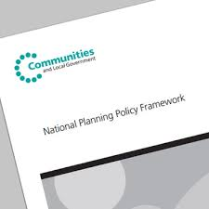
National policy
this is mainly found in the National Planning Policy Framework (July 2021) –available to read online
the NPPF has implications for both local plan-making and how applications are assessed. The NPPF is always being updated – and doesn’t require new legislation (because it’s policy, not law). Some changes have been flagged recently.

Slide 30
A democratic deficit? “Bottom-up” or “top-down?”
Can national policies override local ones?
YES! For example:
where there is no relevant development plan policy
but (more likely) where the relevant policy (or policies) are seen to be out of date
in these cases, the current NPPF contains “a presumption in favour of sustainable development”.….

Slide 31
....which means that permission should be granted, unless specific policies in the NPPF suggest it should be refused, or any adverse effects of the development would “significantly and demonstrably” outweigh the benefits from the scheme (such as the provision of housing where it is needed)
the NPPF still has many “protective” policies – eg open space, valued landscapes, biodiversity, Green Belt, flood risk, the historic environment etc. New refs to climate change (2021) – to be beefed up in the next version?
and it reiterates the primacy of the DP: so, where an application conflicts with an up-to-date Development Plan, “permission should not usually be granted”

Slide 32
The end of the housing numbers game?
Local Plan examinations and planning appeals have been dominated for years by arguments about housing numbers – especially the Council’s ability to demonstrate a 5-year supply of housing land (and even about how that should be calculated). Local communities have not been properly engaged in all this
…. but are there are some signs that the Govt finally wants to put less emphasis on the numbers and more on creating sustainable places that people can support? Michael Gove seems to have got the message

Slide 33
a short break….

Slide 34
“Other material considerations”
Three areas …..
we’ve just seen that national planning policy is an important material consideration, in addition to the Development Plan
there’s also the views of consultees / third parties
and specific factors on the ground, because every case is different
it’s a fundamental principle that every application should be considered on its individual merits

Slide 35
views of consultees/third parties
statutory consultees - 25 in total e.g.
- the relevant highways authority
- Environment Agency
- Natural England
- Historic England
- Sport England
- Health & Safety Exec
- the lead local flood authority
- water and sewerage undertakers
- and Parish and Town Councils
general publicity
The minimum legal requirement is that LPAs “shall take account of” all these views – but how much weight should be given to them is a matter of planning judgement – not a question of law

Slide 36
Does it matter what we say?
Parish and Town Councils are part of local democracy –they should be able to influence the debate about outcomes
one way is to engage fully with the plan-making process – the preparation and updating of the Local Plan
another is responding to invitations to comment on individual planning applications
remember that the weight of public opinion (for or against) is not a material consideration – it’s not a referendum!

Slide 37
Responding to planning applications
restrict your comments to material planning considerations, and forget about everything else
if you’re objecting to something, be clear whether it’s the principle you don’t like, or some detail
where possible, refer to current policies and evidence to support / explain the reason for your views

Slide 38
factors on the ground
MATERIAL | NON-MATERIAL
design and visual impact | the applicant or agent
privacy/daylight/sunlight | land ownership
noise, smell, pollution | private rights e.g. access
access/traffic | restrictive covenants
flood risk, sustainability issues | property value
ecology, landscape, historic environment | competition
crime (and fear of) | loss of view
economic impact | “moral” issues (eg gambling)
planning history/related decisions | numbers of representations
health / health and safety | change from previous scheme
cumulative impact

Slide 39
Any questions about this list?

Slide 40
some other factors
the economic viability of the proposed development has become increasingly relevant – and controversial. This might constrain what it is reasonable to ask for in negotiations – the amount of affordable housing, for example
the personal circumstances of an applicant will very rarely be material (whereas the needs of a business could be – e.g. a case for an additional dwelling on a farm)

Slide 41
some related matters
wider policy objectives (such as addressing climate change, crime and disorder considerations etc) are in the background – but might sometimes come to the fore (for example, the pros and cons of a new power station)
the Listed Buildings & Conservation Areas Act 1990 may be relevant
don’t forget the Building Regulations – planning permission may not be permission to build
we can generally assume that the Human Rights Act is automatically complied with – as long as the system operates the way it is supposed to

Slide 42
The options for decision-makers

Slide 43
Approvals
If a decision seems to conflict with the development plan, there must be a clear explanation / justification to maintain public confidence in the process – especially important if permission is being granted
approvals are usually subject to conditions (which may be appealed against)
and they may involve consideration of an obligation under s.106, which has its own disciplines

Slide 44
Conditions
most conditions are routine and the need for them is clear – but some may need specific justification, especially if unusual or potentially onerous
it’s important that they’re only imposed where they can be justified – a good question to ask is “without this condition, would permission have to be refused?”
Government has laid down six tests for conditions, which haven’t changed over the years, and to which Inspectors and the courts give considerable weight

Slide 45
Two types of permission
Full (permission usually valid for three years), where the principle and much detail are submitted together
Outline (more complex validity) - only for the erection of a building, and where one or more details are ‘reserved' for later consideration: these are (a) access (b) appearance (c) landscaping (d) layout (e) scale
The local planning authority can usually ask for more detail before trying to reach a decision

Slide 46
Refusals
refusing permission is a serious matter – it must be clearly justified by reference to policies and any other material considerations in the case
may be subject to appeal, so reasons should at least be defensible and based on credible evidence
unreasonable refusals or conditions may result in costs awards against the LPA; but considered decisions properly defended will not, even if the appeal itself is successful
Notes:
This advice is endorsed in PINs document: Procedure Guidance Planning Appeals - April 2014

Slide 47
Appeals 1.
There is an automatic right of appeal to the Secretary of State against:
refusal of planning permission
refusal of reserved matters application
any conditions imposed
a failure to determine within the statutory timescale

Slide 48
Appeals 2.
there is no right of appeal against a grant of planning permission (i.e. a “third party” right)
Inspectors and the Secretary of State have to play by the same rules as the Local Planning Authority - they are effectively reviewing the Council’s own planning judgement
Inspectors are independent - not “agents” of Government (but of course have to take proper account of Govt policy and advice)
so, as with the Council, decisions on appeals must (a) start with the policies in the development plan; and (b) have regard to all other material considerations

Slide 49
watch this space….

Slide 50
2021 saw the Johnson Govt. proposing very radical reforms to the planning system. This drew heavy criticism from Conservative-voting areas (eg Amersham) and elsewhere, so it looked as though they’d be shelved – until……
the Truss Govt. seemed to put some of them back on the agenda: eg exempting developers from having to build affordable homes, the scrapping of environmental protections and allowing people to add extensions without permission all being floated
but of course, that was then…….signs that the Govt may be thinking it has other priorities at the moment?

Slide 51
A final thought
we all know that the process is not fully understood (or in some cases even trusted) by many people
however, planning remains (for now at least) one of the diminishing areas of local discretionary control, still basically subject to democratically-based public scrutiny. Many people have been worried about recent steps to remove or dilute it
But let’s face it, whichever way it’s done……

Slide 52
it’s not always easy!
Notes:
ARE THERE ANY SPEAKERS NOTES OR POINTERS AS TO WHAT (IF ANYTHING) NEEDS TO BE SAID IN RELATION TO THIS SLIDE?

Slide 53
Appendix
Recent changes to permitted development
and changes of use – some detail

Slide 54
2020 PD rights (1) roof-top extensions and new dwellings
upward extension of existing buildings by 1-2 storeys
demolishing and rebuilding, incl. adding storeys
different rules depending on whether existing building is residential or commercial
both require prior approval generally not applicable to designated areas, listed buildings
complex rules…….

Slide 55
2020 PD rights (2) creation of new dwellings
Class A: up to 2 storeys of new dwellings on top of detached, purpose-built blocks of flats
Class AA: ditto on top of commercial or mixed-use detached buildings (must be at least 3 storeys)
Class AB: as AA, for commercial etc terraces
Class AC: as AA for residential terraces
Class AD: for single-dwelling detached property
all subject to max height of 18m (30m for Class AA)
only applies to buildings built 1948-2018

Slide 56
2020 PD rights (3) demolition and rebuild
rebuilding of unused buildings as blocks of flats or a house
applies to demolition of existing blocks of flats, office/ light industry (or a mix)
has to be built pre-1990 and have been vacant for at least 6 months
has to be less than 18m in height, max of 1000 sq. m.
the newbuild must be on same footprint, no more than 7m taller than original

Slide 57
from 1 August 2021….
…any commercial, business and service uses [the new and very large Class E group] can change to residential up to max of 1500 sq m
need to have been in a Class E use for at least 3 years, and continuously vacant for at least 3 months
exempt from s106 / CIL

Slide 58
The Use Classes – a summary
Class E commercial, business and service uses, including shops, offices, restaurants and cafes, light industry, assembly and leisure etc
Class F1 learning and non-residential institutions
Class F2 local community uses including rural shops, community halls, outdoor sport or recreation
Class B2 general industry (unchanged)
Class B8 storage and distribution (unchanged)
Class C1 hotels, guest houses etc)
Classes C2/C2a residential institutions
Class C3 dwelling houses
Class C4 houses in multiple occupation - HMOs)
NB: some uses are “Sui Generis” (ie in a Class of their own – or in no
Class). So to change to or from them will require permission – examples include pubs, wine-bars and takeaways, night clubs, hostels, amusement centres, car sales, scrap yards…..

Slide 59
The Use Classes 1
Class E commercial, business and service uses
(a very wide group of activities):
shops, financial and professional services (not health)
restaurants and cafes (not pubs or takeaways)
business (eg office, light industry)
non-residential institutions (medical / creches / nurseries / day centres)
assembly and leisure (indoor sport, fitness etc)

Slide 60
The Use Classes 2
Class F1 : learning and non-residential institutions
education, galleries, libraries, worship, courts etc
Class F2 local community uses
small isolated shops, community halls, outdoor sport or recreation
Class B2
general industry (as before)
Class B8
storage and distribution (as before)

Slide 61
The Use Classes 3
Class C1
hotels, guest houses etc)
Class C2
residential institutions
Class C2a
secure residential institutions
Class C3
dwelling houses
Class C4
use of a house by 3-6 unrelated residents sharing facilities (houses in multiple occupation - HMOs)

