Slide 1
North & South Kesteven
Local Policing Overview
Superintendent Phil Baker
September 2025

Slide 2

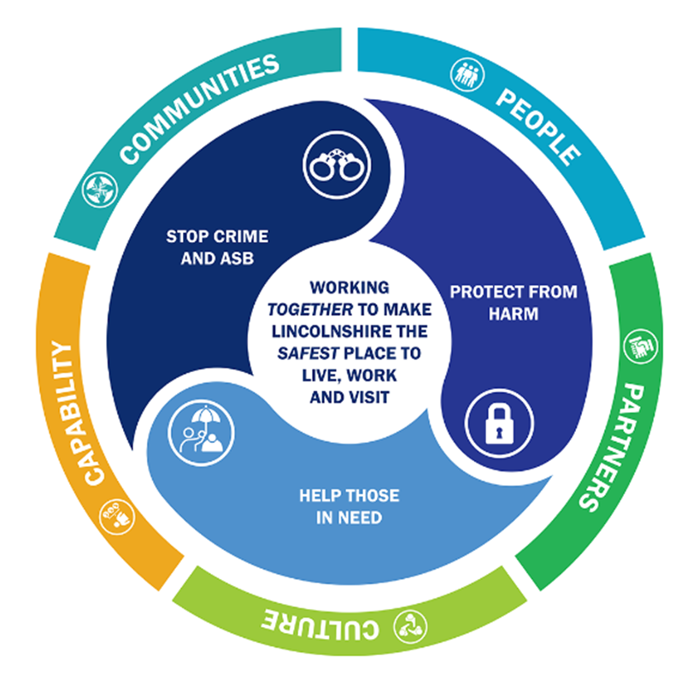
  Keeping Lincolnshire Safe

Slide 3

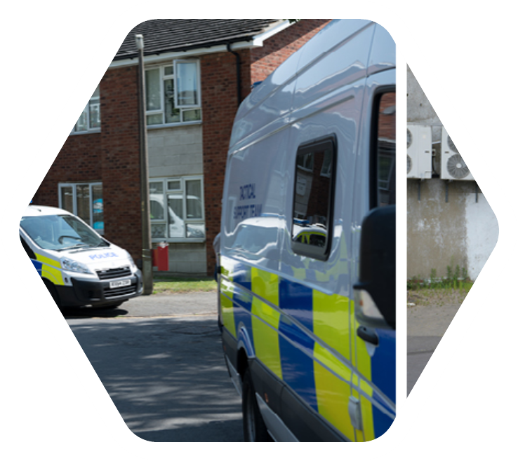
  Local Policing

Slide 4
The Statistical Process Charts (SPC) are graphs used to study how a process changes over time. The main aims of using SPC charts are to understand what is ‘different’ and what is ‘normal’.
SPC charts require a minimum of 10 data points in order to create a valid chart, although there is increased reliability when using 20 or more data points. Data should also be plotted chronologically in date or process order, usually shown as distinct data points. The following are then calculated:
Average (mean) based on the previous rolling 36 months to end of the current / most recent reporting month. Any data sets that do not have a full 36 months, use the entire available data set, until a full 3 years are available.
Standard Deviations used to determine how far a value is from the mean. The SPC charts are set to two standard deviations.
Seasonal averages are based on the same month for the last 3 years, including the most recent year. For example, the seasonal average for August 2025 is calculated from the average of August 2023 , August 2024 and August 2025.

Slide 5
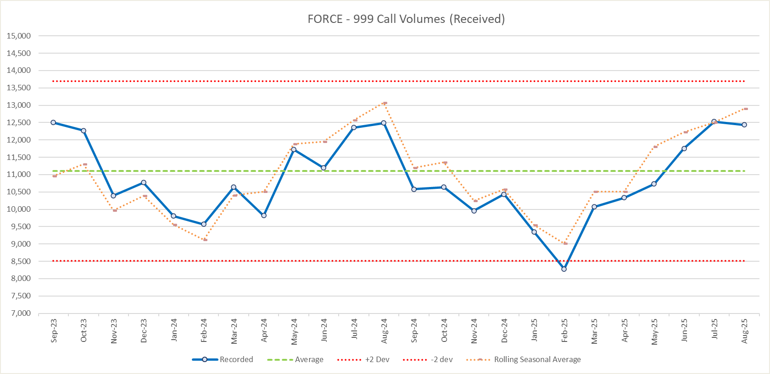
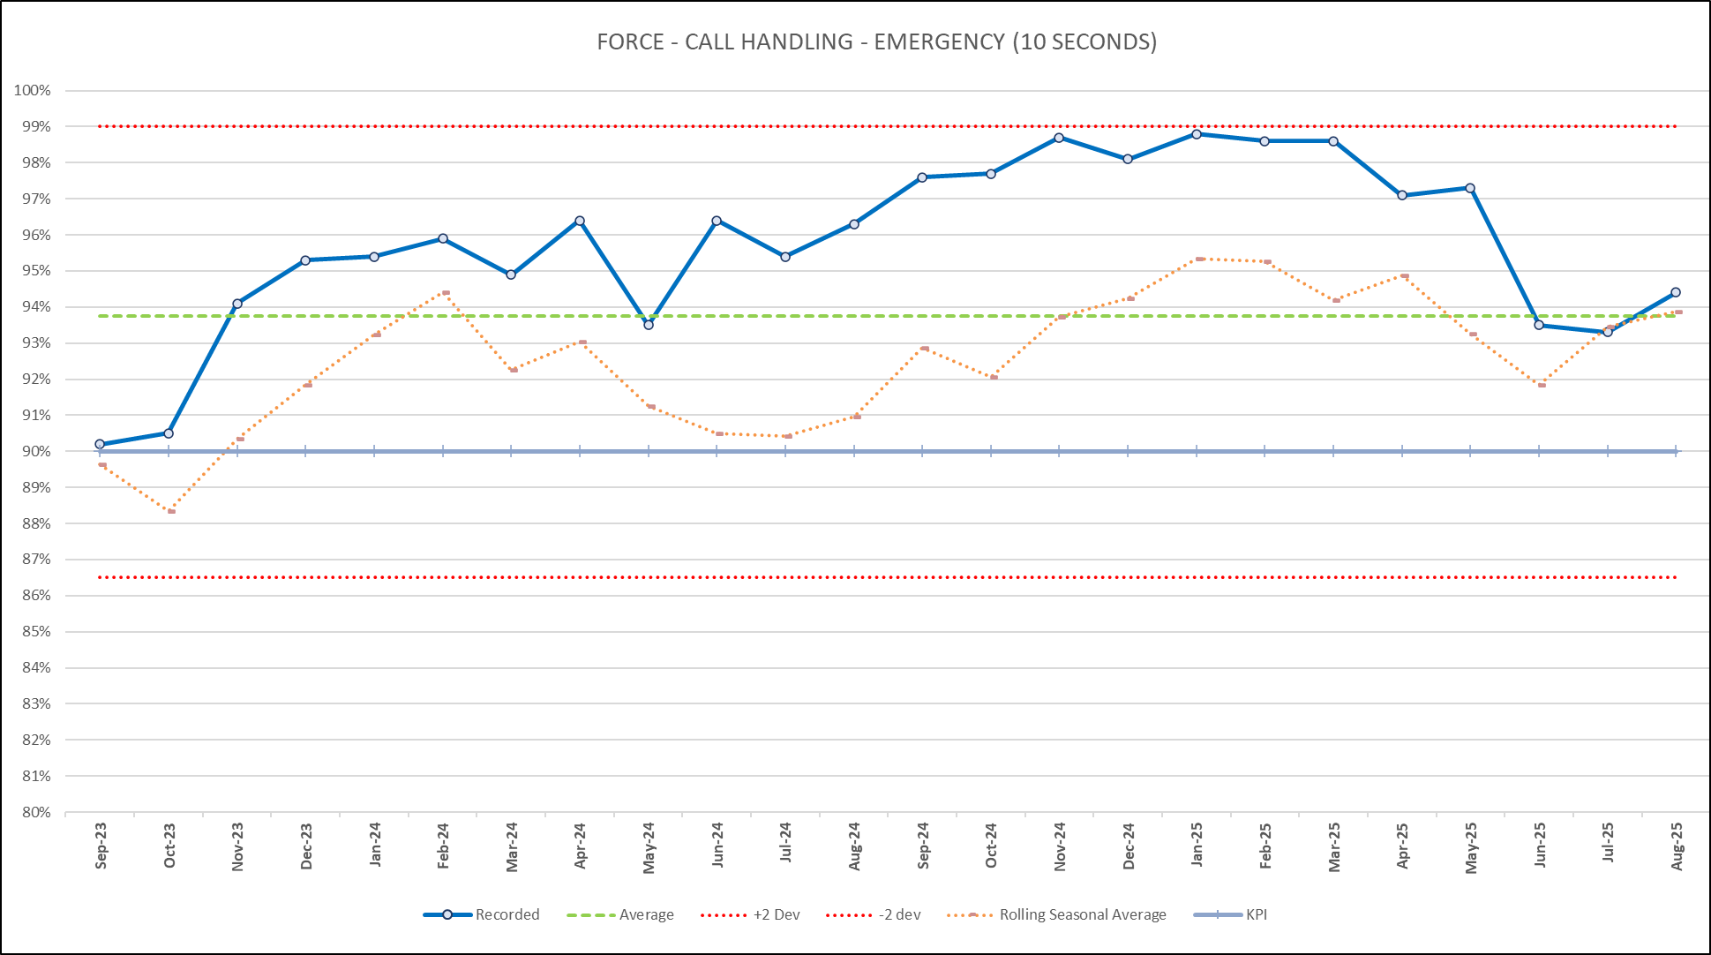
  Force Call Handling - 999

Slide 6
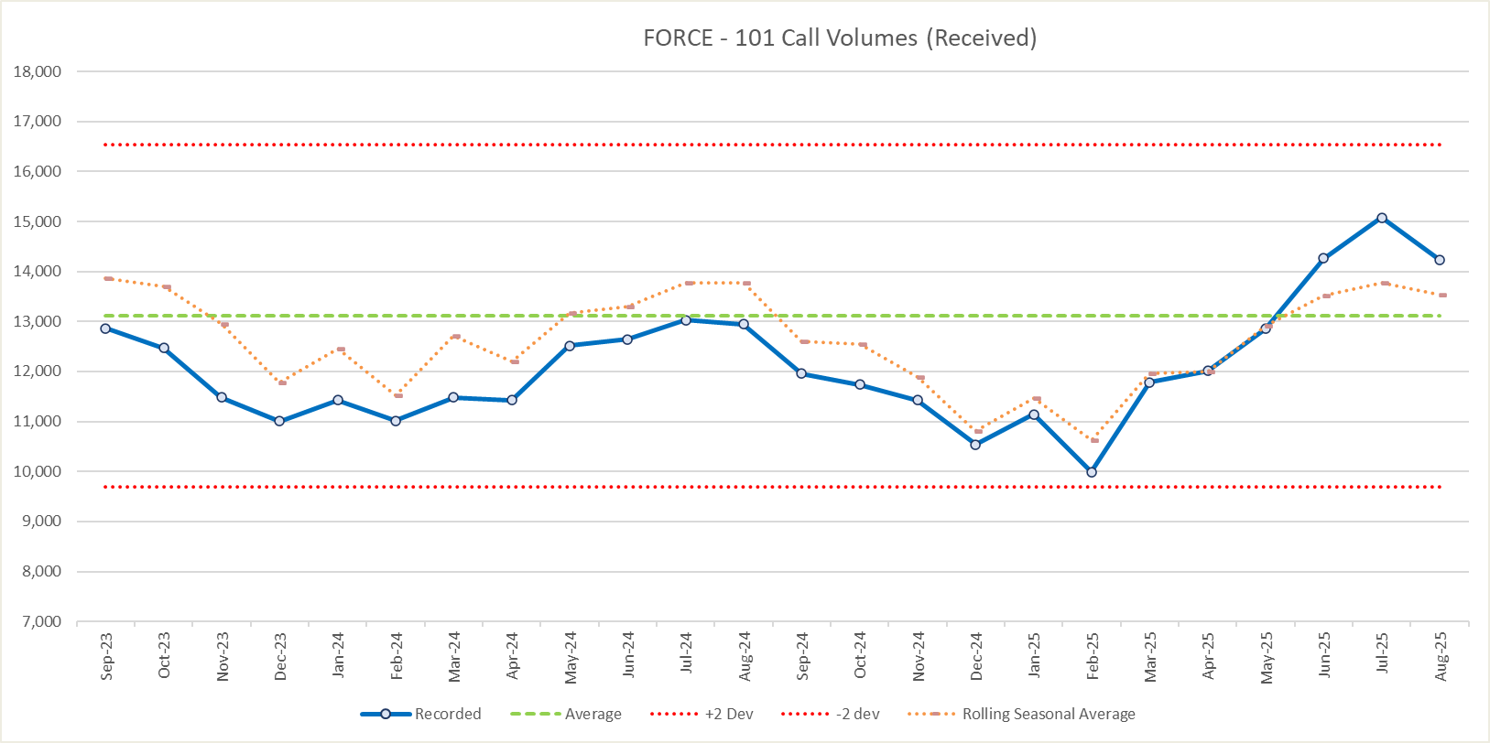
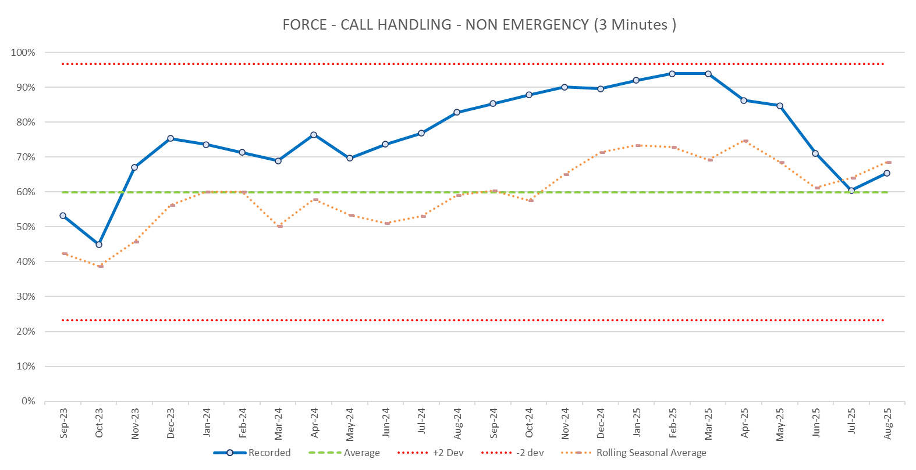
  Force Call Handling - 101

Slide 7
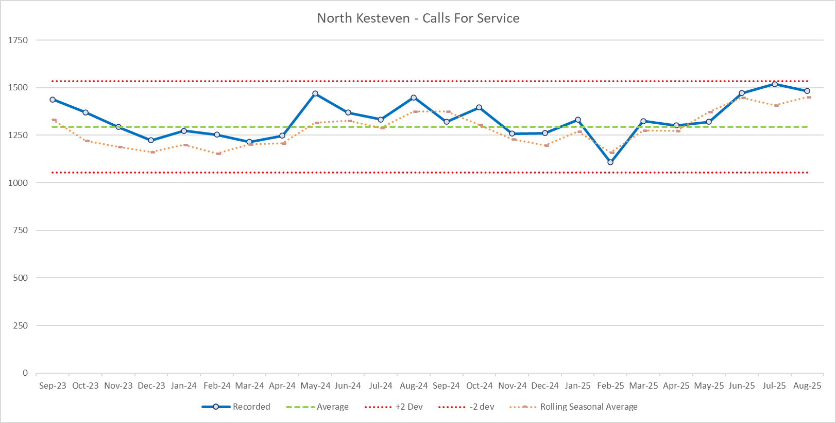
  Calls for Service – North Kesteven

Slide 8
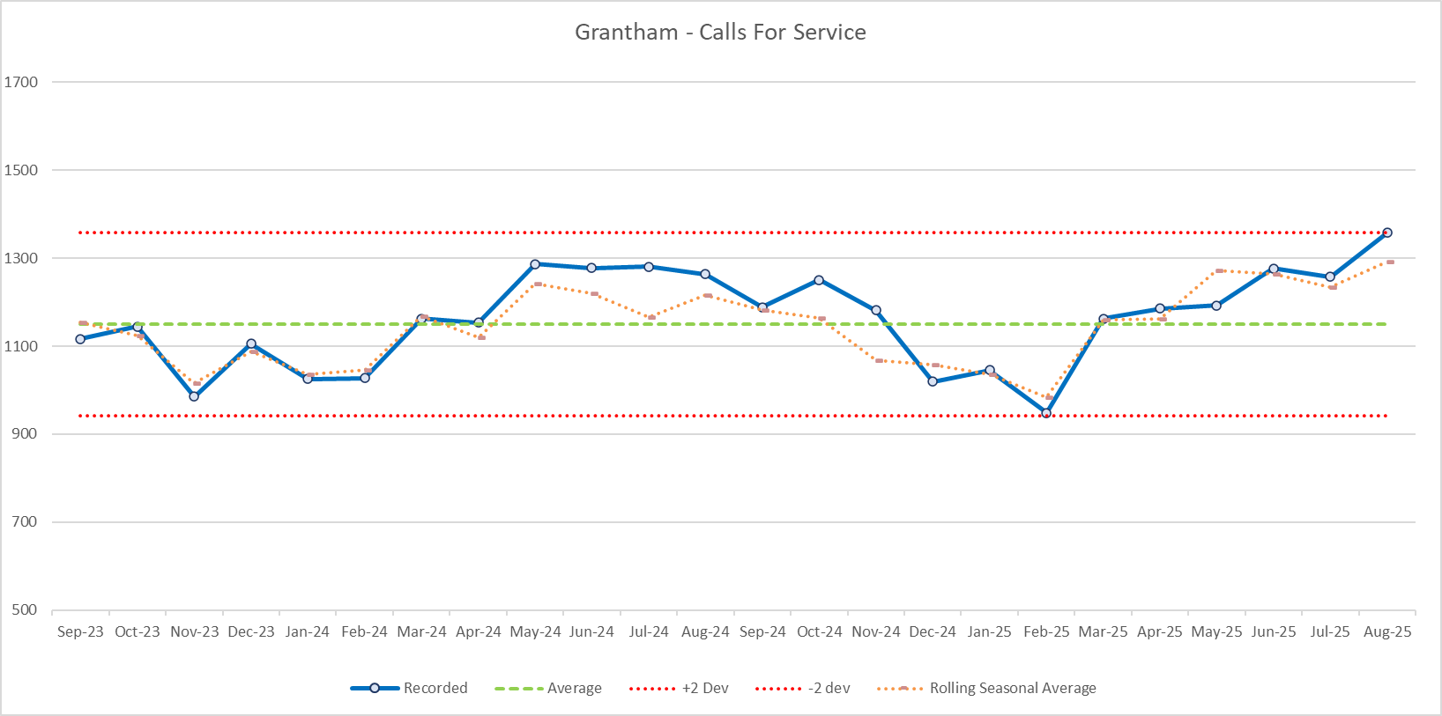
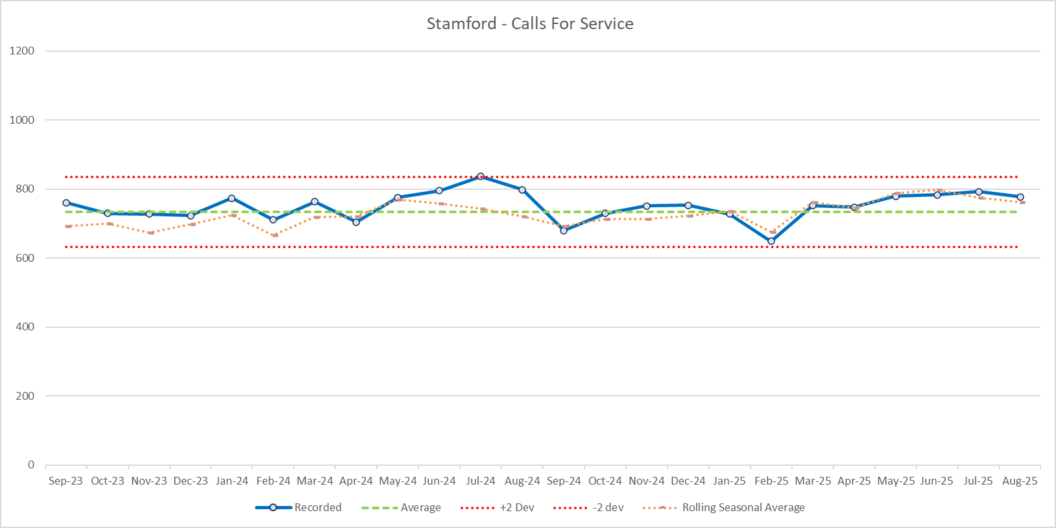
  Calls for Service – South Kesteven

Slide 9
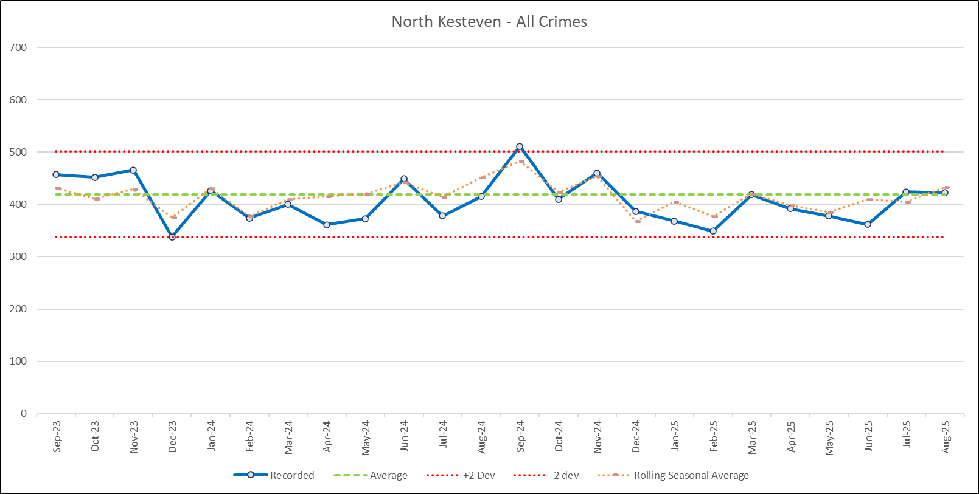
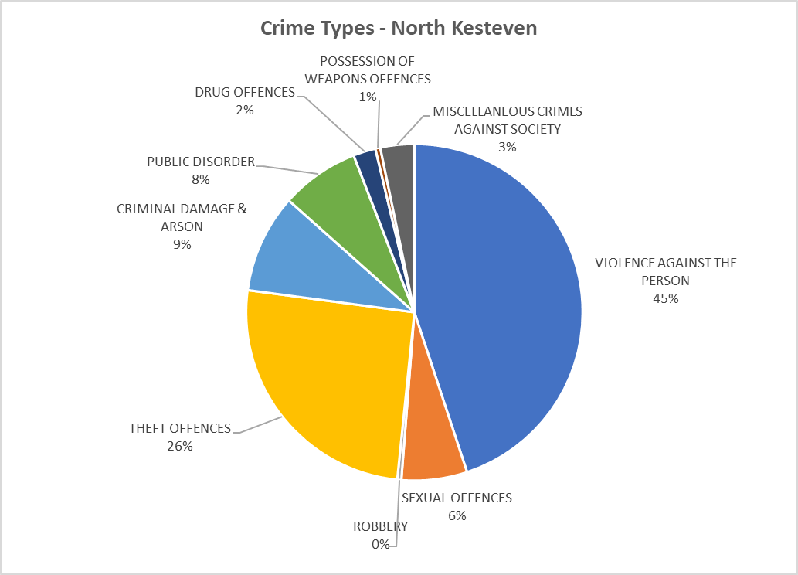
  All Crime – North Kesteven
Breakdown of offences in the top 3 crime groups over the last 12 months = Sept 24 to Aug 25

Slide 10
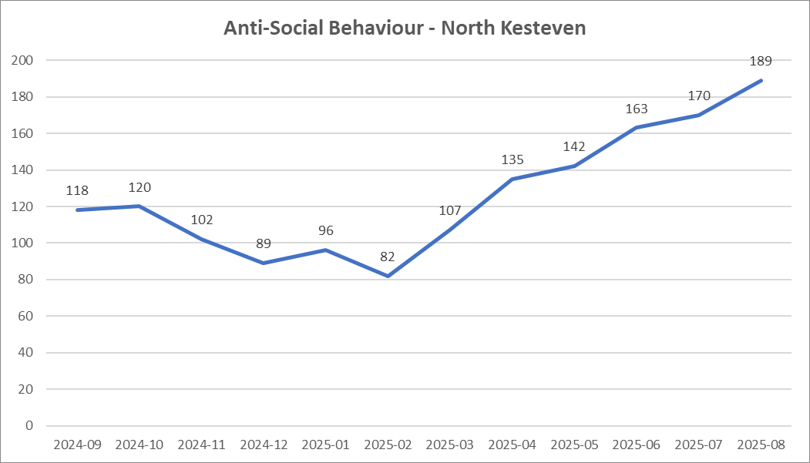
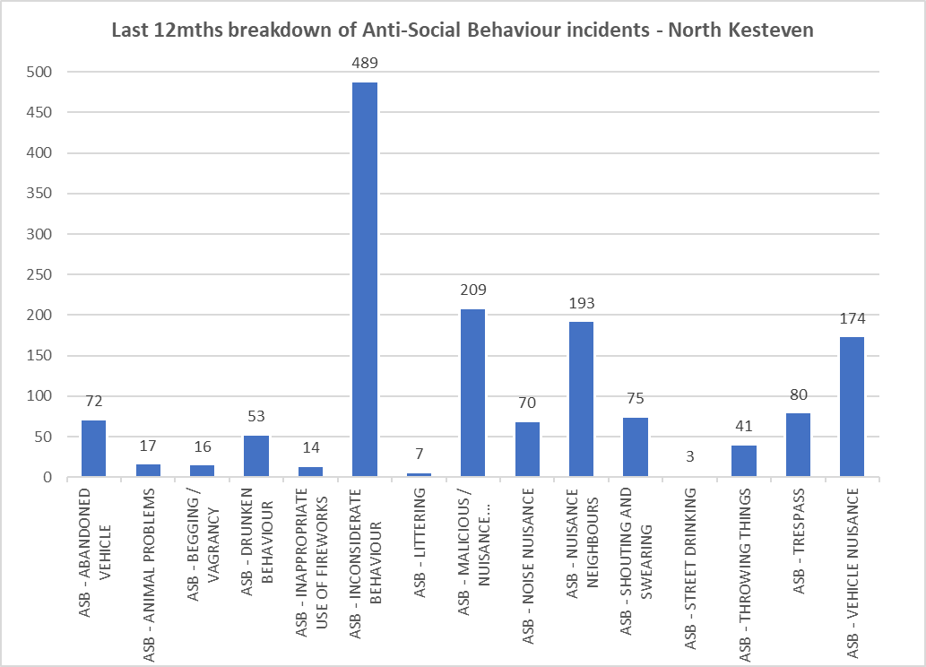
  Anti-Social Behaviour – North Kesteven

Slide 11
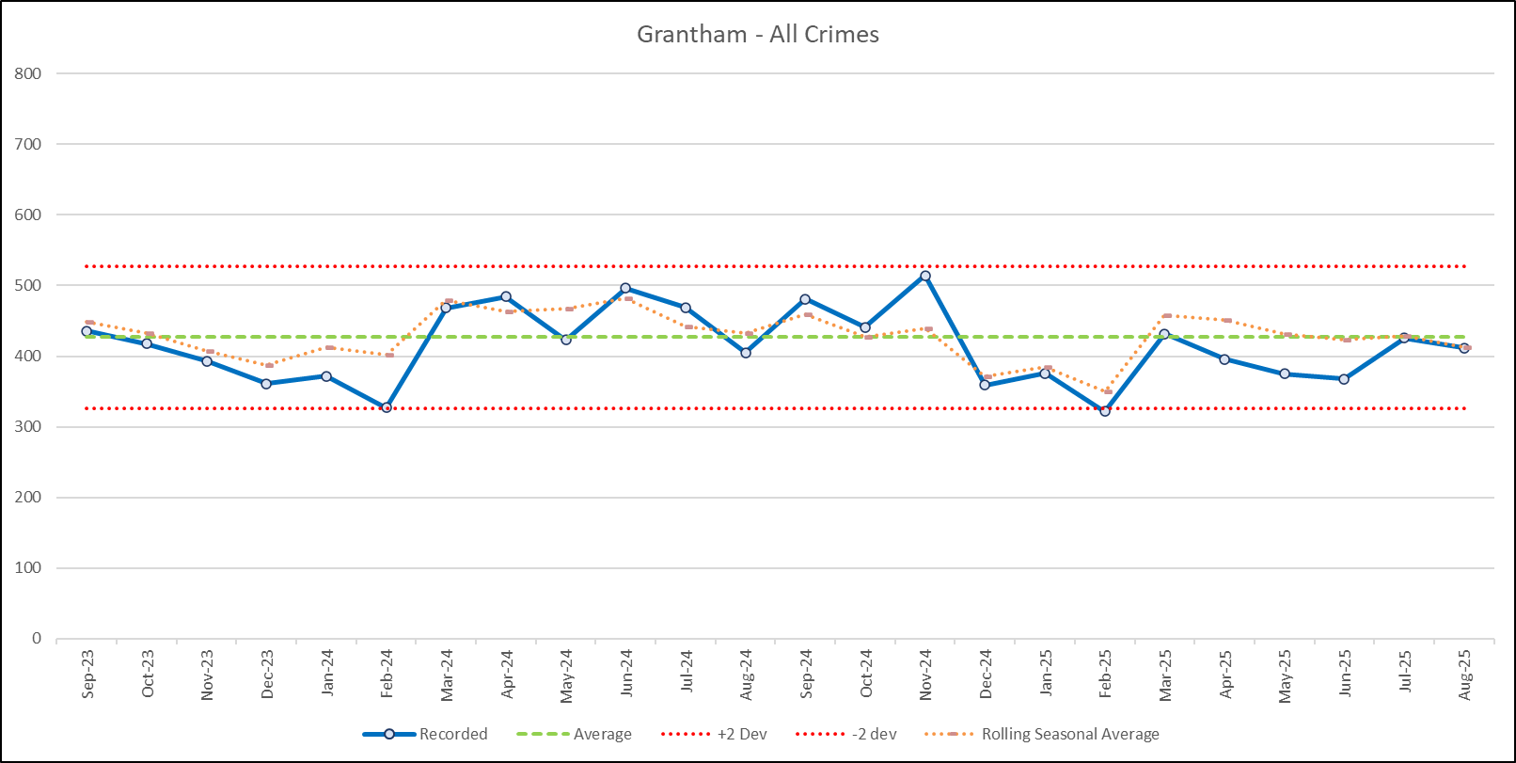
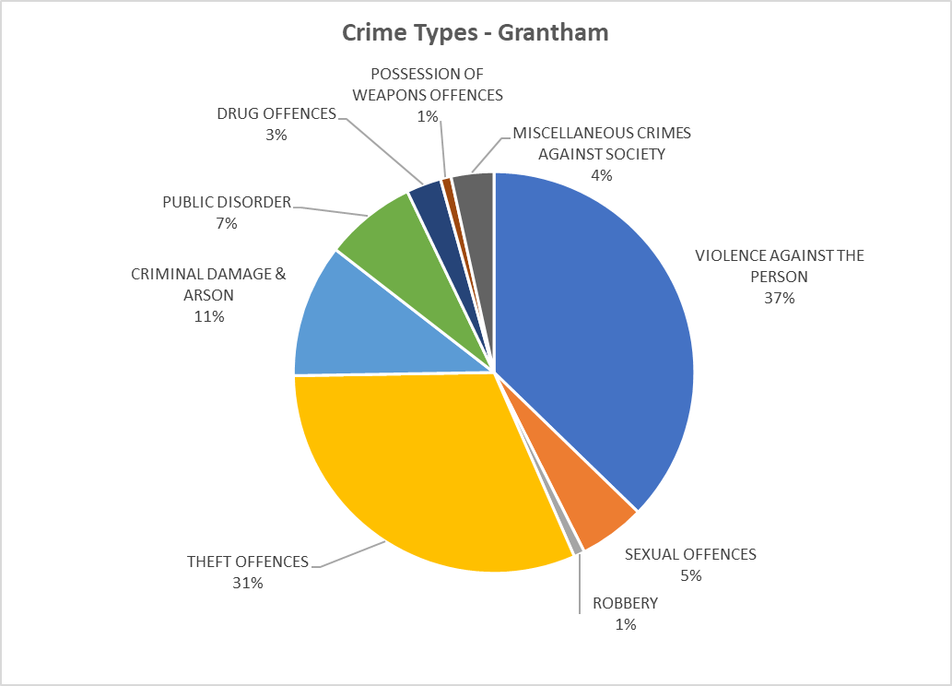
  All Crime – Grantham
Breakdown of offences in the top 3 crime groups over the last 12 months = Sept 24 to Aug 25

Slide 12
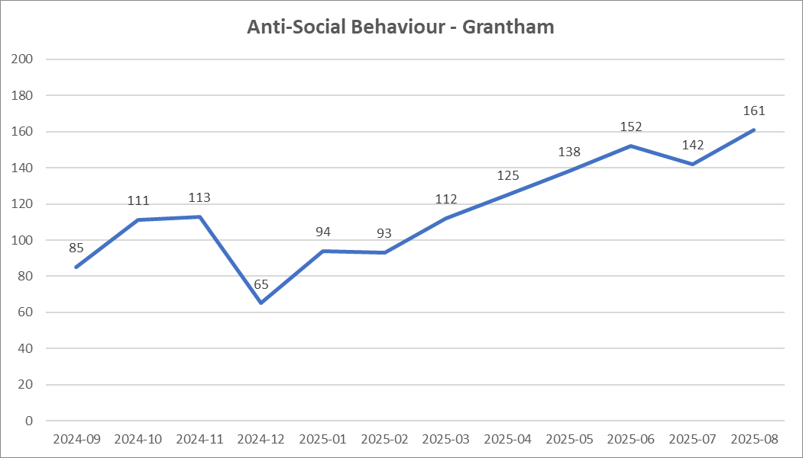
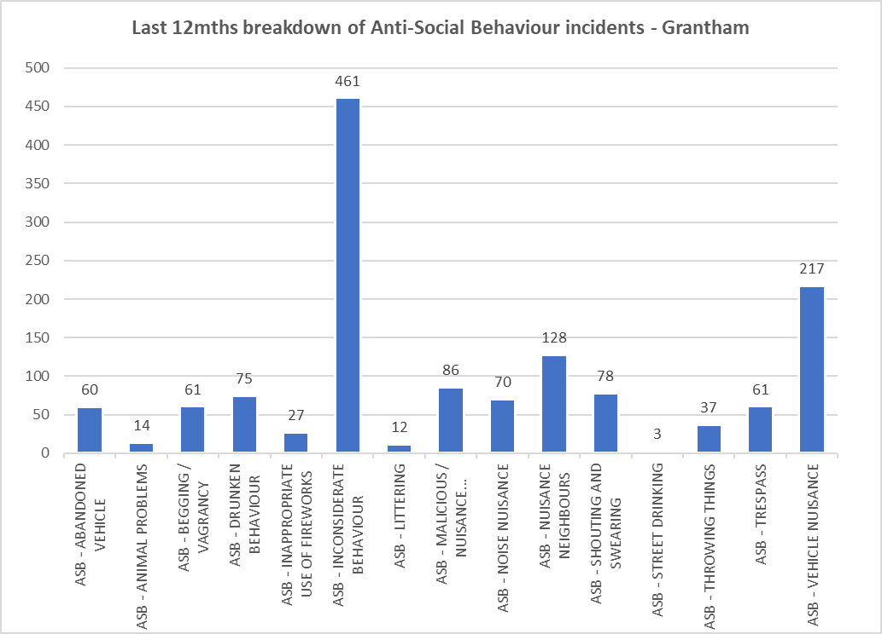
  Anti-Social Behaviour – Grantham

Slide 13
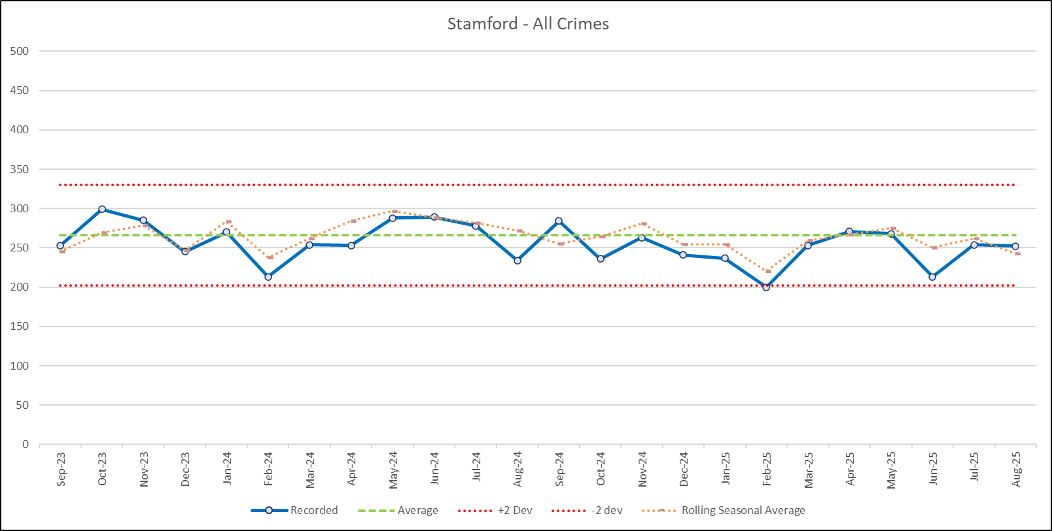

  All Crime – Stamford
Breakdown of offences in the top 3 crime groups over the last 12 months = Sept 24 to Aug 25

Slide 14
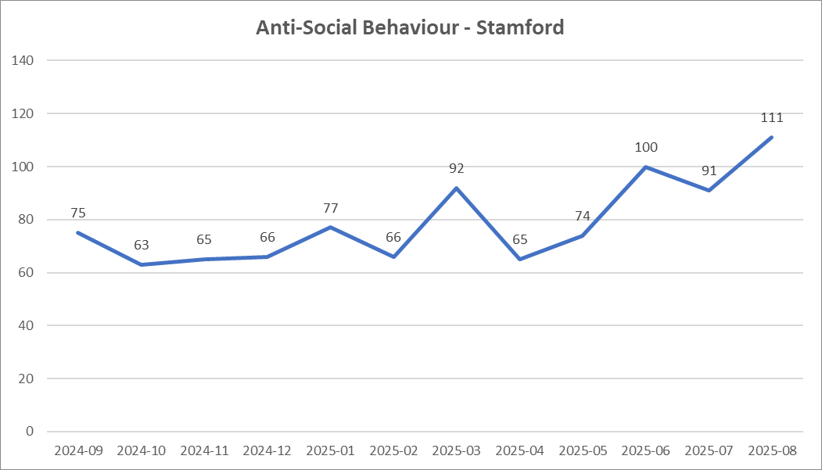
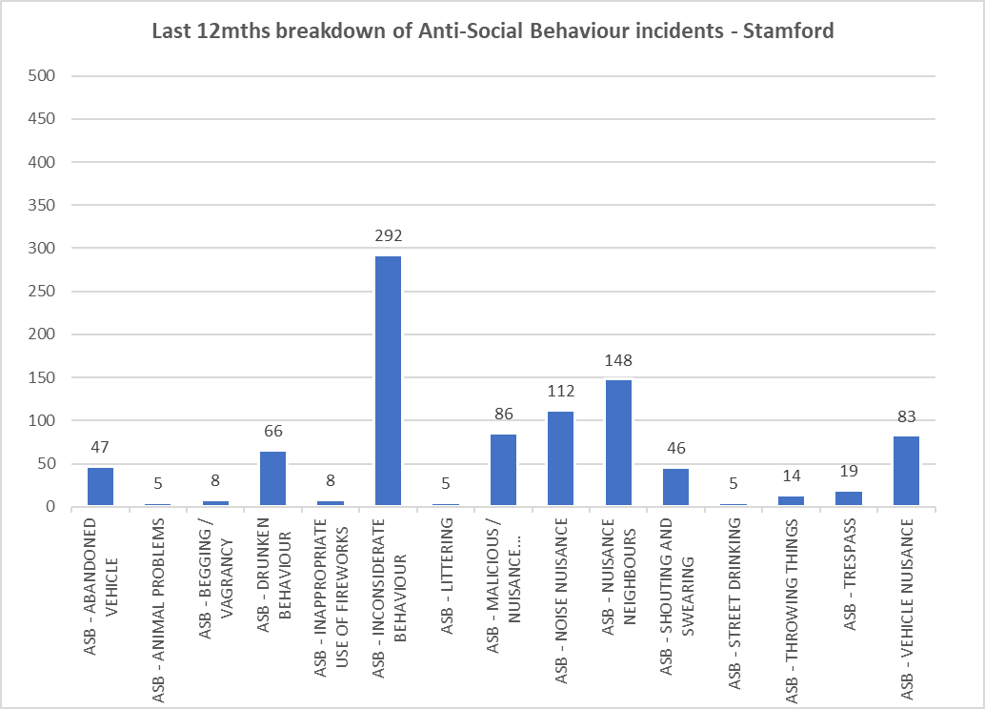
  Anti-Social Behaviour – Stamford

